Slide 1

CYCLISTIC BIKE-SHARE

Slide 2
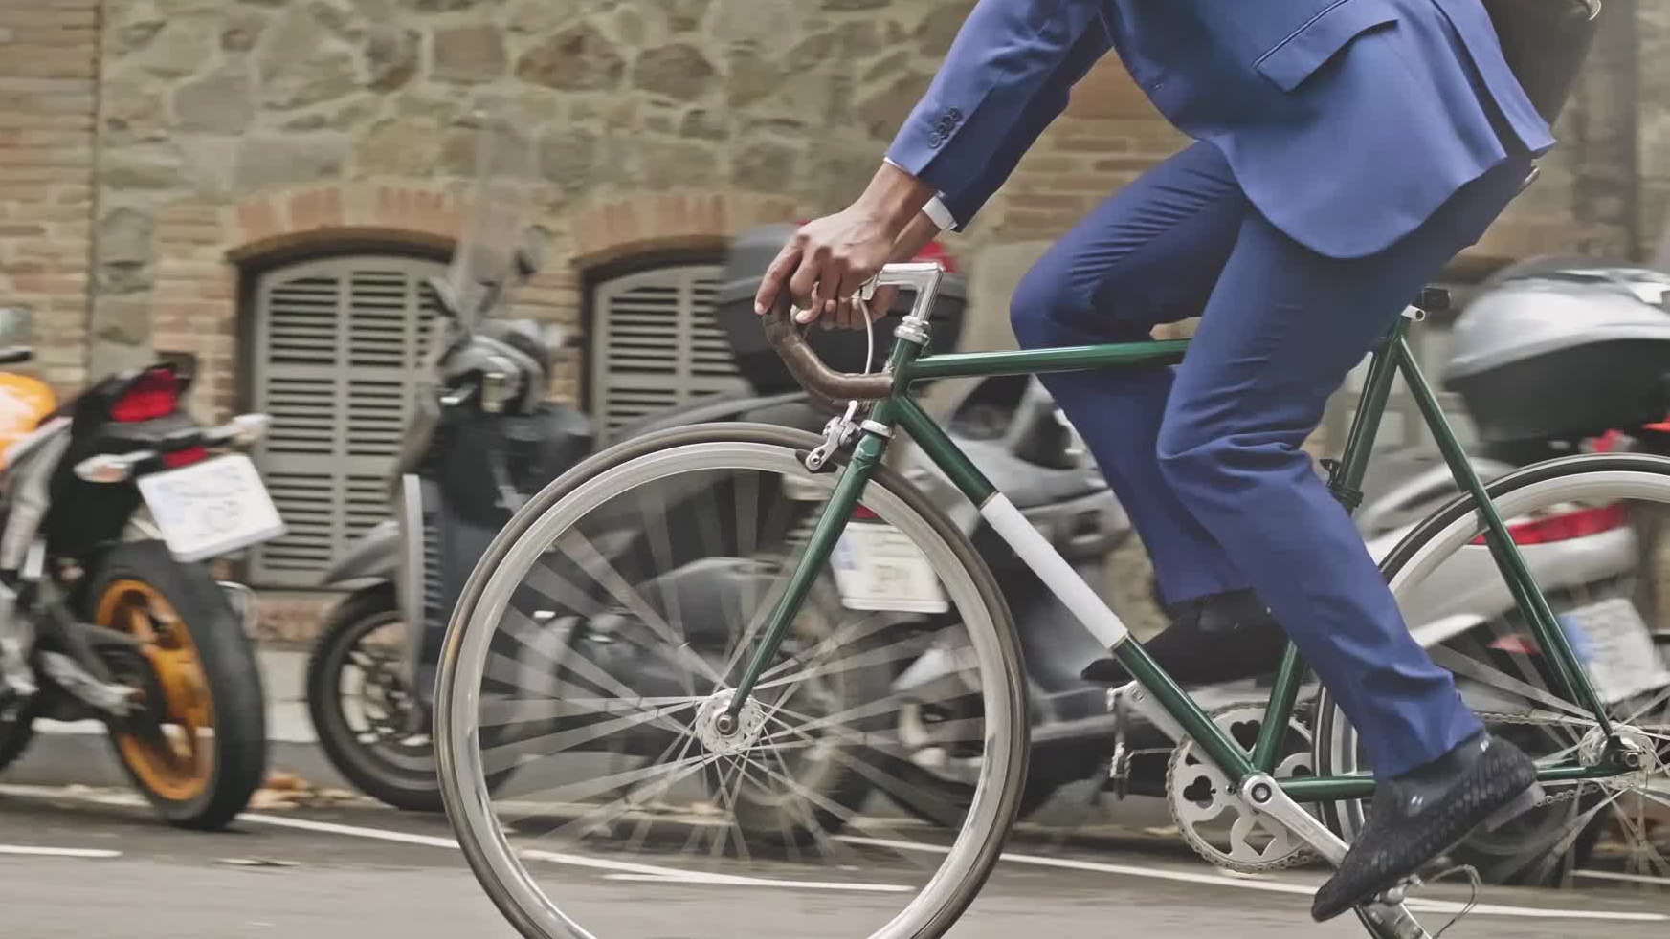
How do annual members & casual riders use bikes differently?

Slide 3

Factors chosen:
Total rides
Number of rides by day of the week
Average ride length
Average ride length day of the week
Number of rides by rideable types
Number of rides by time of the day

Slide 4
Total Rides
For the past 12 months, member trips accounted for about 55% of total trips while casual riders accounted for 45% of total trips.

Slide 5
Number of rides by day of the week
Casual riders took more bike rides on weekends in comparison to members who took more rides on weekdays.

Slide 6
Average Ride Length
Casual riders’ trips were about twice as long

Slide 7
Average ride length day of the week
Casual riders rode the bikes for longer for each of the days.
Average ride length is higher during the weekend for both types of riders

Slide 8
Number of rides by rideable types
Overall, both preferred the classic bike
Casual riders used all the types of bikes unlike members who did not use docked bikes at all.
Members used the electric & classic bikes more than the casual riders.

Slide 9
Number of rides by time of the day
For each of the time of day, member riders had more trips except at night

Slide 10
Seasonal total rides
Members had more trips than casual riders except during the summer

Slide 11
Seasonal average ride length
Shows a similar pattern as the 12-month review; casual riders’ trips were almost twice as longer as members’ trips

Slide 12

Thank you!

